Slide 1

G2M Case Study
Virtual Internship
1.Data understanding
2.Identify relationship between data
3.Cleanning & Preparing data
4.Feature analysis
5.Dataset relations
6.summry
17-Dec-2022
Srinivas Devarajula

Slide 2
Background – G2M(cab industry) case study
Bussiness Problem : XYZ is a private firm in US. Due to remarkable growth in the Cab Industry in last few years and multiple key players in the market, it is planning for an investment in Cab industry and as per their Go-to-Market(G2M) strategy they want to understand the market before taking final decision.
Objective : Provide actionable insights to help XYZ firm in identifying the right company for making investment.
Areas to investigate:
Which company has maximum cab users at a particular time period?
Does margin proportionally increase with increase in number of customers?
What are the attributes of these customer segments?

Slide 3
Dataset
Data have been provided in 4 individual data sets (31/01/2016 to 31/12/2018)
Cab_Data.csv – this file includes details of transaction for 2 cab companies
Customer_ID.csv – this is a mapping table that contains a unique identifier which links the customer’s demographic details
Transaction_ID.csv – this is a mapping table that contains transaction to customer mapping and payment mode
City.csv – this file contains list of US cities, their population and number of cab users
The analysis has been divided into four parts:
Data Understanding
Forecasting profit and number of rides for each cab type
Finding the most profitable Cab company
Recommendations for investment

Slide 4
Data Exploration
24 Features( including 9 derived features)
Timeframe of the data: 2016-01-31 to 2018-12-31
Total data points :355,032
Assumptions:
Outliers are present in Price_Charged feature but due to
unavailability of trip duration details ,we are not treating this as outlier.
Profit of rides are calculated keeping other factors constant and only
Price_Charged and Cost_of_Trip features used to calculate profit.
Users feature of city dataset is treated as number of cab users in the city.
we have assumed that this can be other cab users as well(including Yellow and
Pink cab)
Cab_Data.csv
Customer_ID.csv
Transaction_ID.csv
City.csv
USholiday.csv
Final cab data

Slide 5
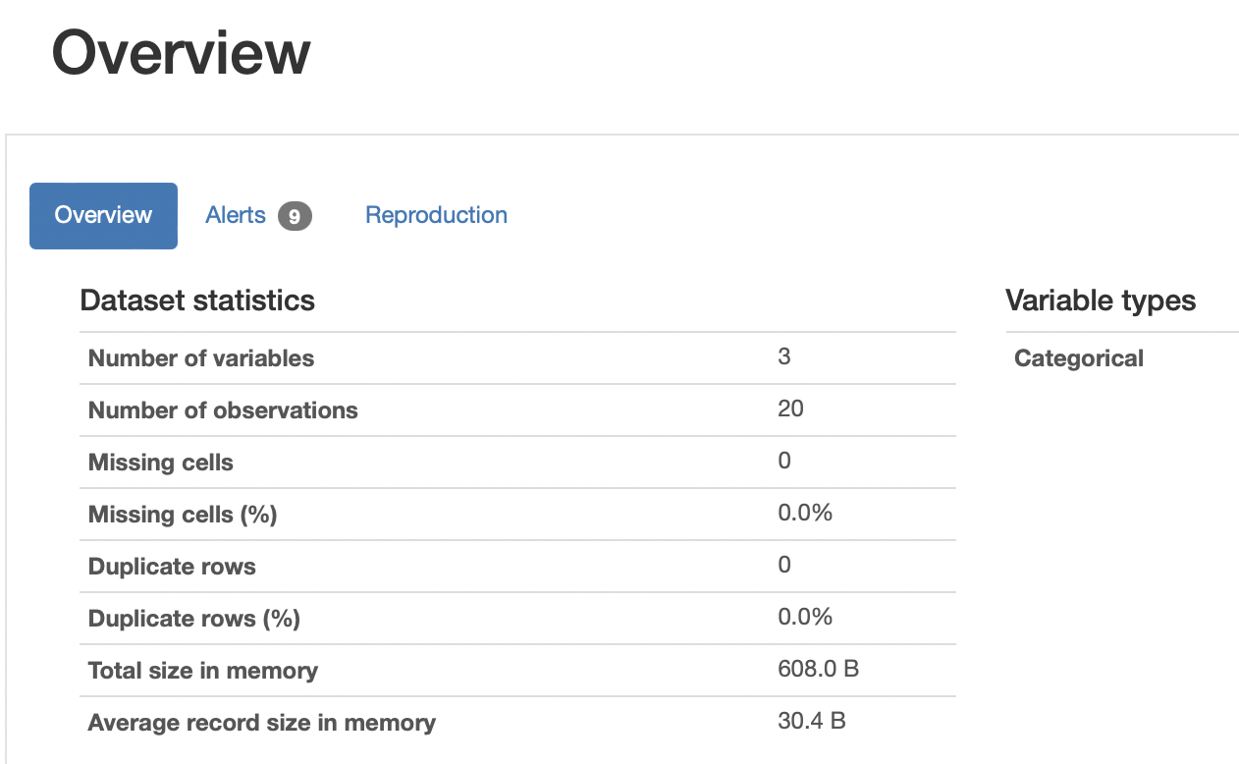
Data cleaning
Pandas Profiling to perform statistical analysis
Used profiling to get statistics about each column in all 4 data files. Used Profiling to know categorical, numeric types in City_data profiling shows whole data statistics, displays each column Distinct, Missing, Null, Unique values and correlation between all columns in dataset.
Removed ',' in population and users column
values and replacing spaces with '_' in column
Names
Converted few columns from object to category/
int64 datatypes
Converted datetime column to datetime, year,
month columns for analysis.

Slide 6
Data Analysis
Analyzed statinfos , distributions , outliers , boxplots , correlations , covariance and so on of some columns
of entire MasterData.
Assumptions:
Outliers are present in Price_Charged feature but due to
unavailability of trip duration details ,we are not treating this as outlier.
Profit of rides are calculated keeping other factors constant and only
Price_Charged and Cost_of_Trip features used to calculate profit.
Users feature of city dataset is treated as number of cab users in the city.
we have assumed that this can be other cab users as well(including Yellow and
Pink cab)

Slide 7
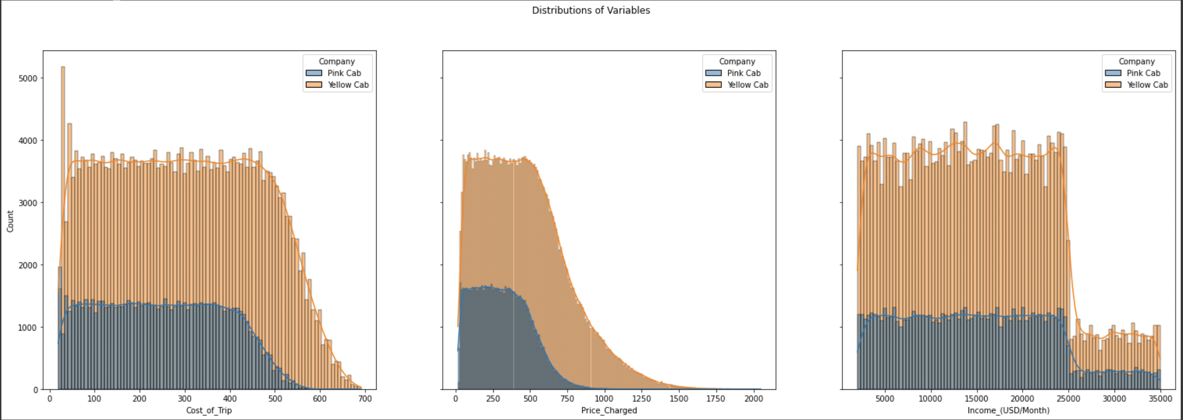
Profit Analysis
Profit Analysis

Slide 8
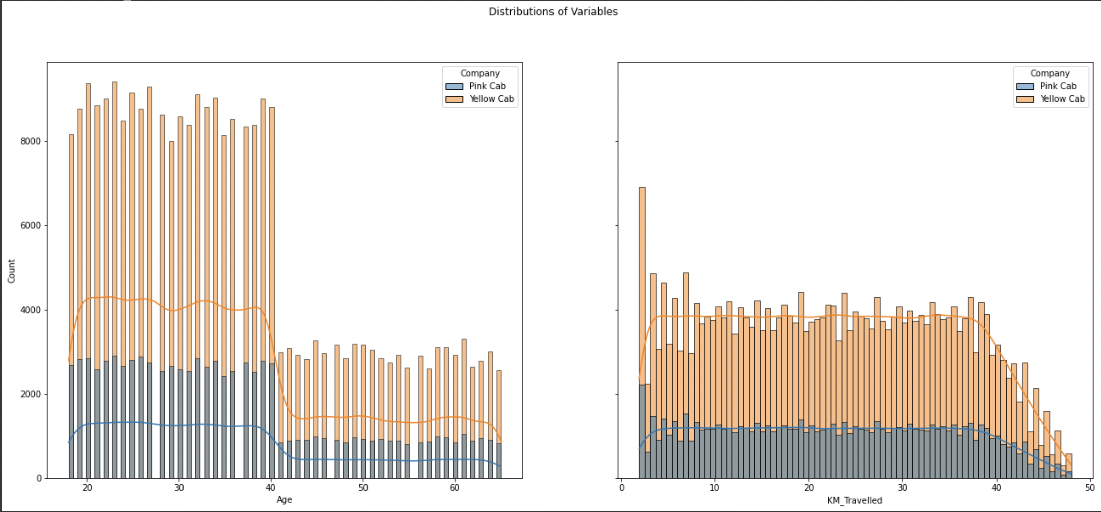
Profit Analysis

Slide 9
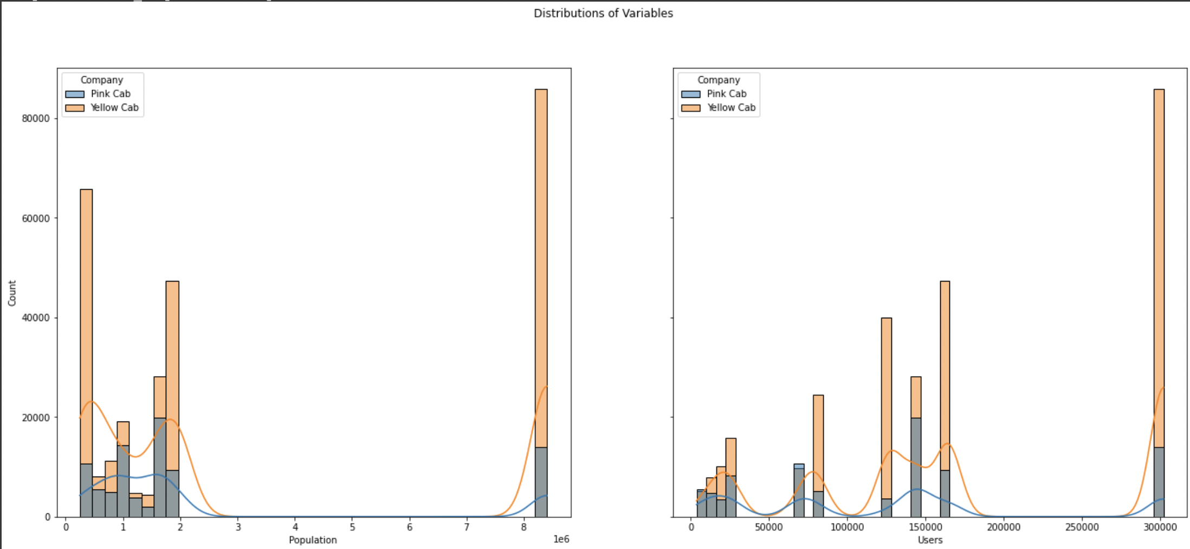
Users and Popluation Analysis

Slide 10
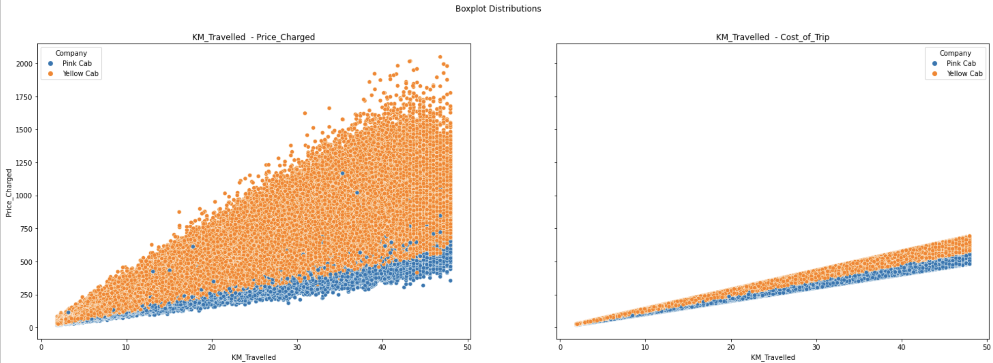
Boxplot Distribution

Slide 11
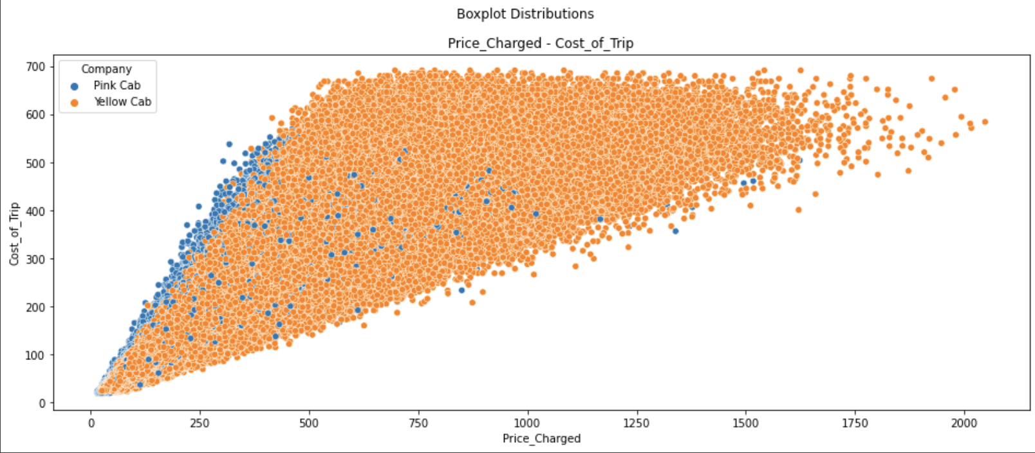
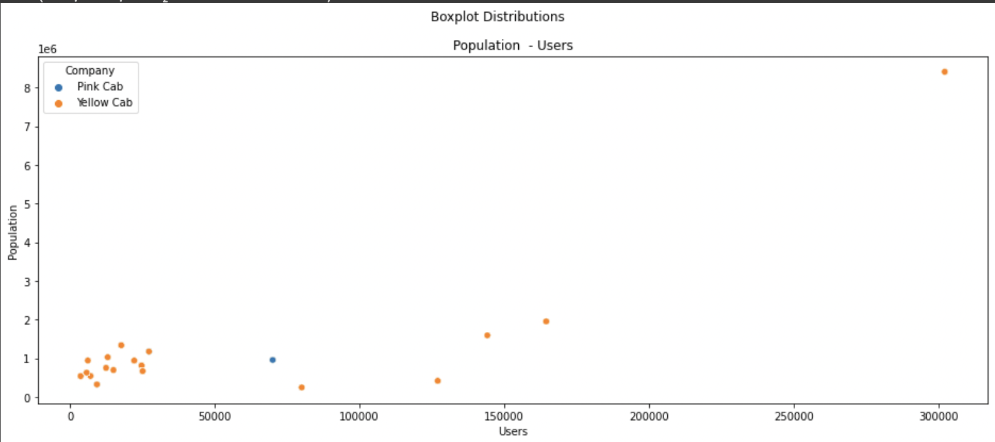
Boxplot Distribution

Slide 12
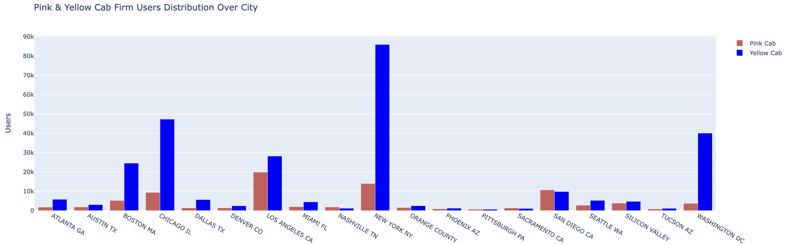
Pink and Yellow cab firm distribution

Slide 13

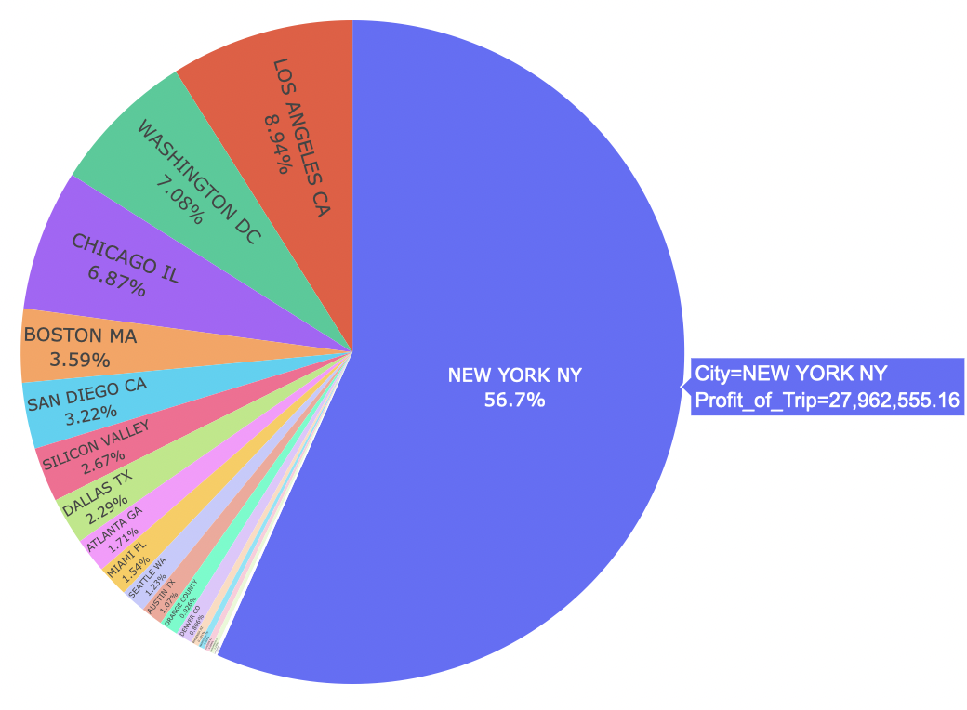
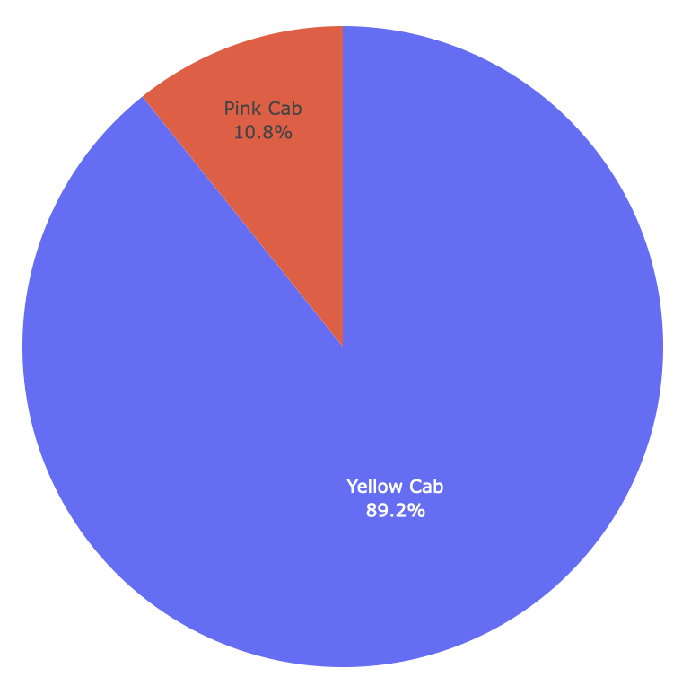
Profit distribution over Cities & Cab Firms

Slide 14
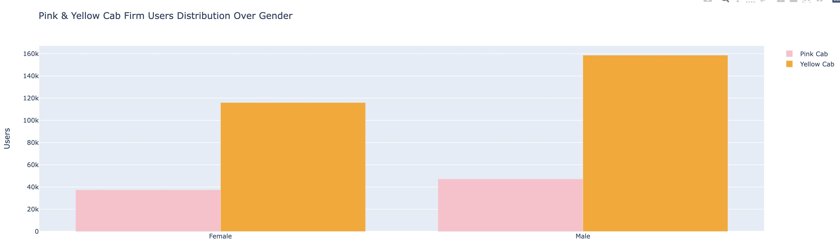
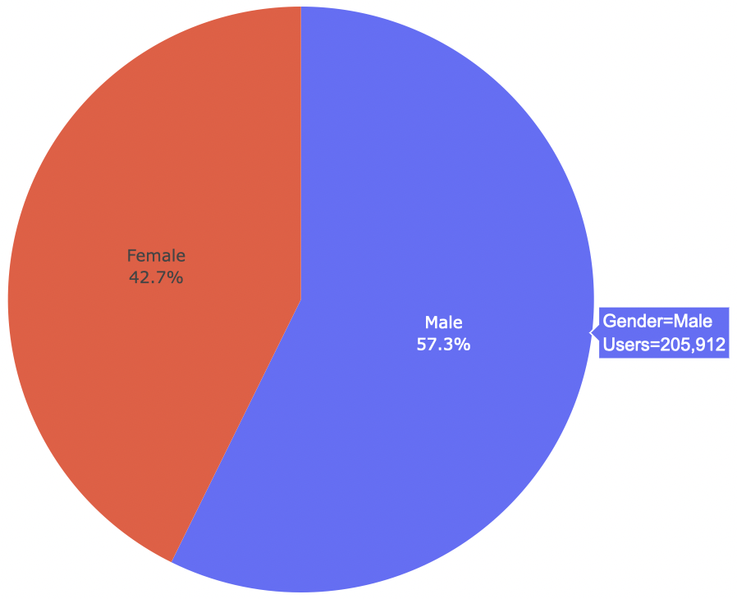
Profit and customer base Analysis Gender wise
There is almost equal distribution of gender in the
Profit and customer base of both the cabs.

Slide 15
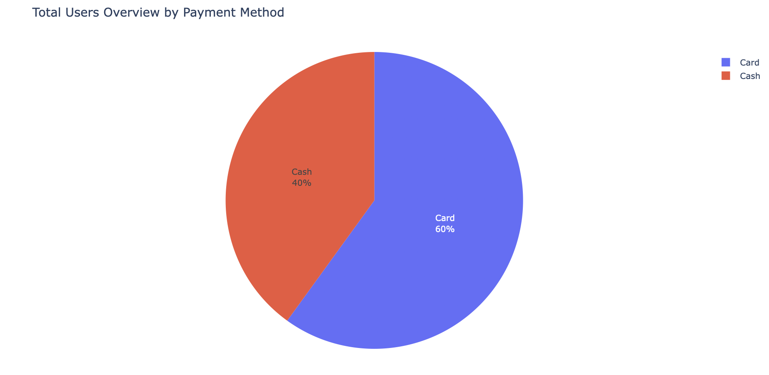
Transaction Analysis - Payment Method

Slide 16
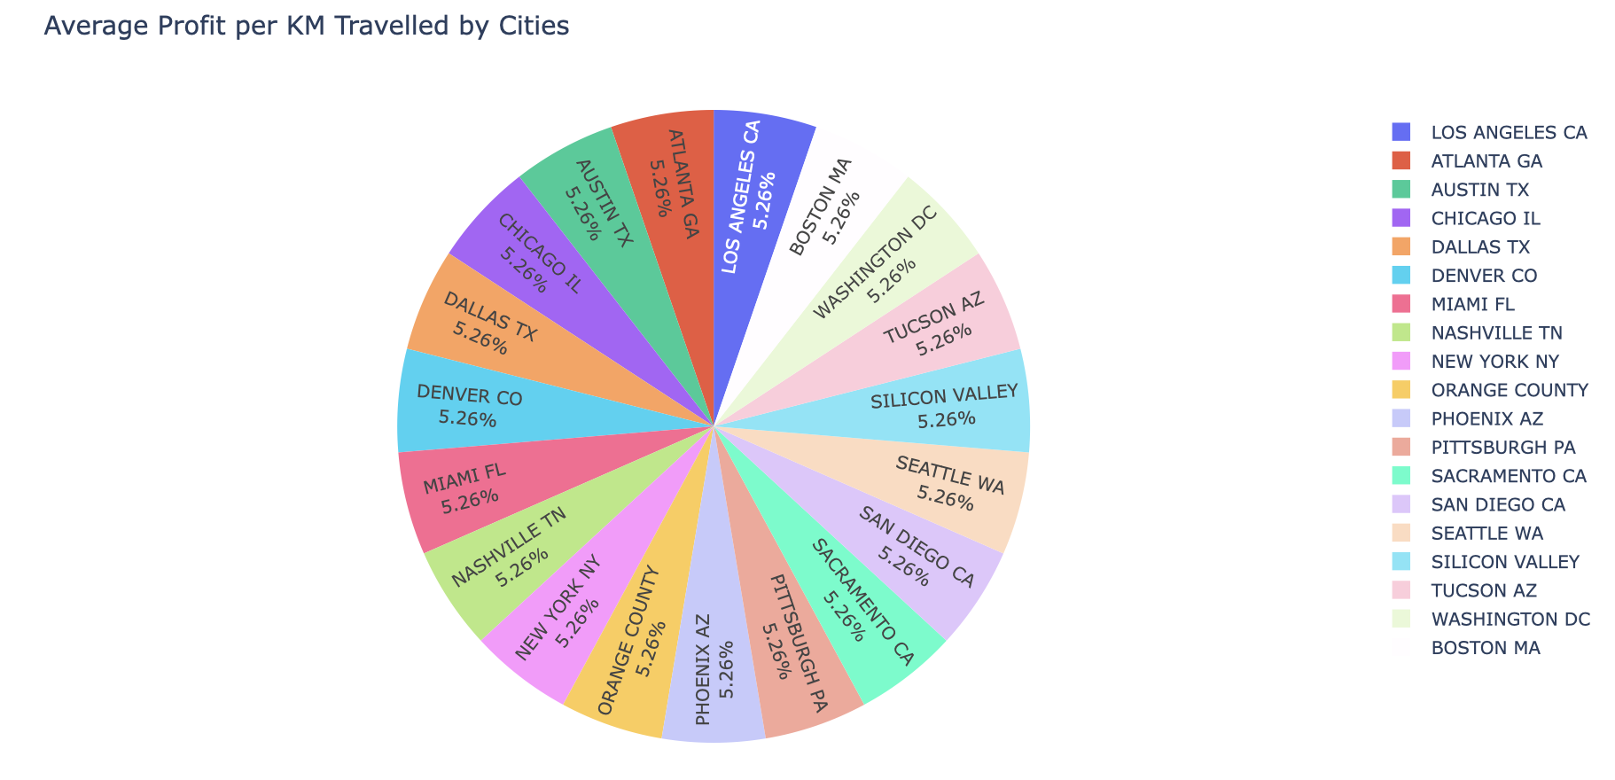
Average Profit Analysis for each city based on per KM

Slide 17
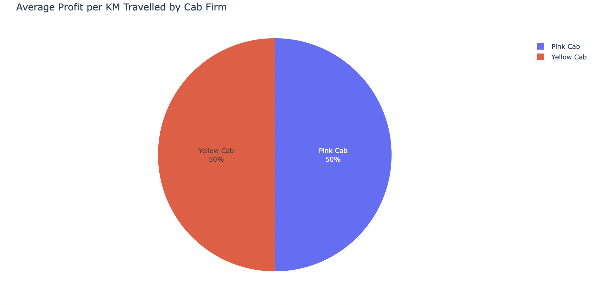
Average Profit per KM travelled by each firm

Slide 18
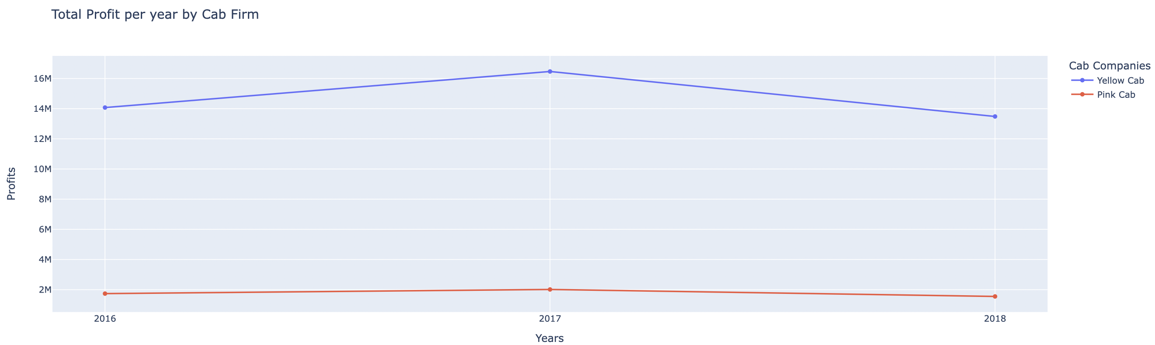
Profit per year Analysis for each firm

Slide 19
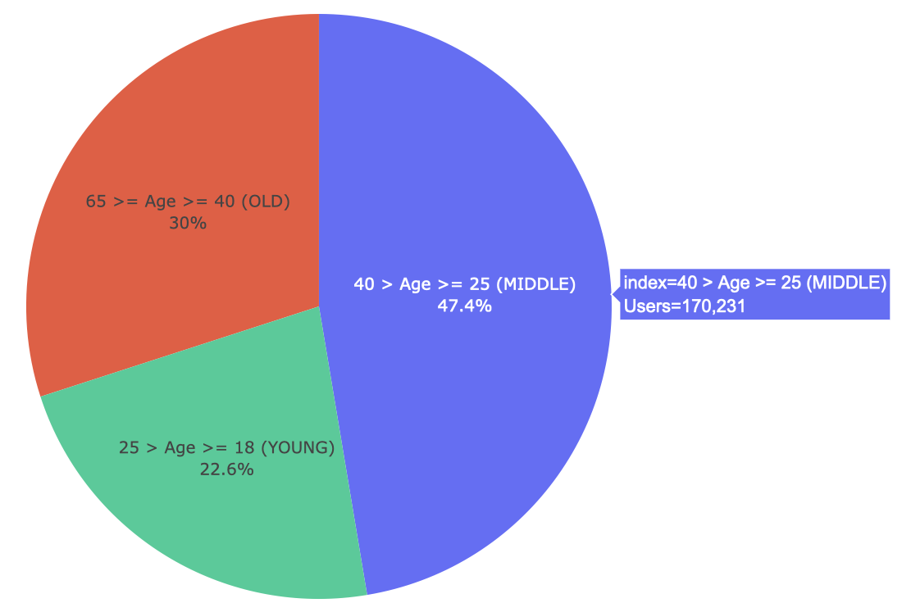
Age GroupWise Profit And Customer Base Analysis

Slide 20
Recommendations
From the visualizations and analysis,
Middle Aged people are more often to use cabs (47.4% are middle aged, 30% old and remaining young)
There is almost equal distribution of gender (57.3 % of males, 42.3% females) in the Profit and customer base of both the cabs.
As per performance, The Yellows cabs has higher distribution than Pink cabs. it seems that Yellow Cabs has higher performance than Pink cabs.
With the help of transactions analysis, the 76.4% of transactions which is more than ¾ share of customers to Yellow cabs from 2016 to 2018) and the rest goes to Pink Cabs. 60% of users uses card and rest use cash.
When It comes to coverage of cities, Its Yellow cabs again with higher coverage percentage and the most popular are NEW YORK NY, BOSTON MA, CHICAGO IL and LOS ANGELES CA. There is a huge difference between yellow and pink cab in customer reach for short and long trip. Yellow cab has very good customer reach in this segment as well.
Yellow cab is performing well as compared to Pink cab on Holidays. Yellow cab is even Performing well In the cities where Pink cab’s customer is more. Out of 19 Cities Pink cab have higher customer reach as compared to Yellow cab ,in following 4 cities (SanDiego, Nashville, Sacramento, Pittsburgh)
As per profit Analysis, Yellow cabs (on avg. 14M on all years ) is making approximately 7 times more profits than Pink cabs (On Avg. 2M on all years) with more users (more transactions), higher performance, and wider coverage of cities.
Middle class and high class contributes more in the profit as well as in the customer base of both the cabs
Overall, From all the analysis, Yellow Cab Firm is bigger than Pink Cap Firm in market Share and It is highly recommended.

Slide 21
Srinivas Devarajula
Thank You

